Slide 1
TOWN OF PALM BEACH ELECTRONIC SOLICITATION SYSTEM
Getting started

Slide 2
Welcome
The Town of Palm Beach is implementing a new intelligent on-line solicitation system. This new system is powered by Negometrix, a company based in the Netherlands. This new system will allow the Town to begin the transformation to the future of Public Procurement. We could bore you with a bunch of information on all the benefits of this system but will briefly tell you the system is fully integrated from planning through contract management.
This new system will provide efficiencies for the Town and you, our suppliers. This new system is different but NOT difficult. We have prepared this brief Getting Started guide to help you register and participate in a solicitation (bid).

Slide 3
LANGUAGE
Since Negometrix is based in the Netherlands some information on some screens may appear in one of the many European languages. Negometrix has made many changes to the system to accommodate this. The language displayed is triggered by the Internet Protocol (IP) Address of the computer/device accessing the website. If the IP Address originates from the United States the website text will be displayed in English. This method is reliable and works very well. If for some reason the language is not correct, the next slide shows a couple of tools you can use to change the text to English.

Slide 4
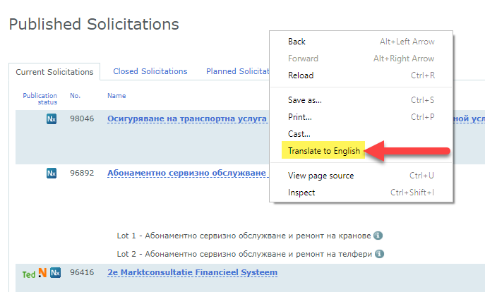
Language tools
In the top left corner of some web browser windows you will see a list of languages listed horizontally. The language highlighted, in this example English (US) is displayed. If language is not displayed in English you can use this tool to change the display to English(US).
Web browsers, such as Google Chrome, have built-in translation tools. If you would like to display a web page in a different language you can right click (in Chrome) anywhere on the web page and select the Translate to English option from the list.

Slide 5
GET STARTED
The easiest way to access a solicitation is to go to the Town’s Negometrix company profile page. To get there . . .
Navigate to https://www.townofpalmbeach.com/
Select Doing Business
Bids & Requests for Proposals
Current Solicitations & Bid Results

Slide 6
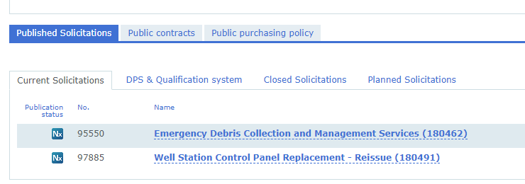
The Public company profile lists all of the Open solicitations for the Town of Palm Beach.
Click on the solicitation title for which you are interested.

Slide 7
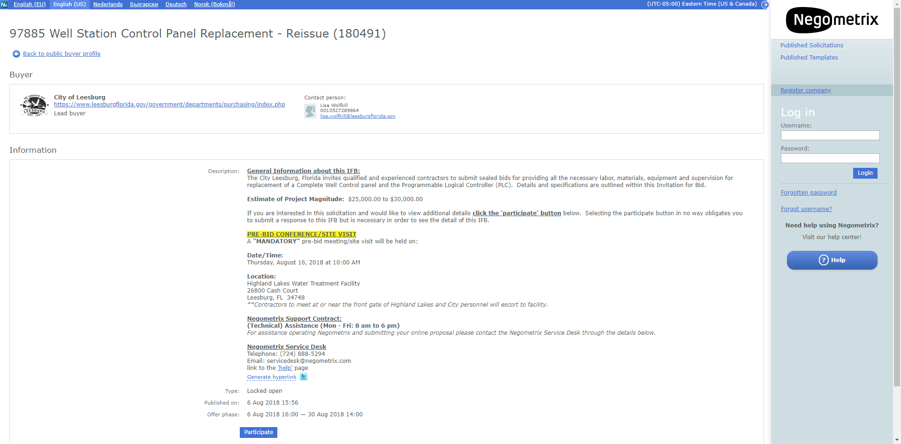
At the bottom of the screen you will see a blue button labeled
‘Participate’.
In order to see the full details of the solicitation you MUST select the Participate button.
Selecting ‘Participate’ in no way obligates you to submit a response to this solicitation. But it is required in order to see more details about the solicitation.
Offer phase = start date - due date
This screen will show the General Information about the solicitation.

Slide 8
After selecting ‘Participate’ this pop-up window will be displayed.
If you have a Negometrix account you can login.
If you do not have an account so you will select the
‘Register Company link’

Slide 9
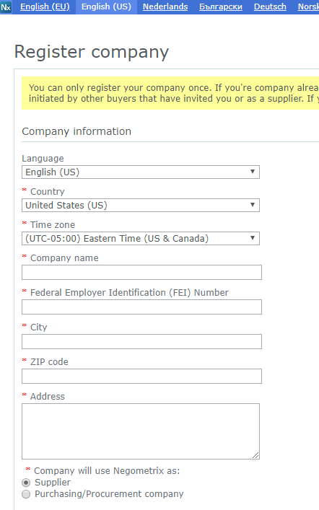
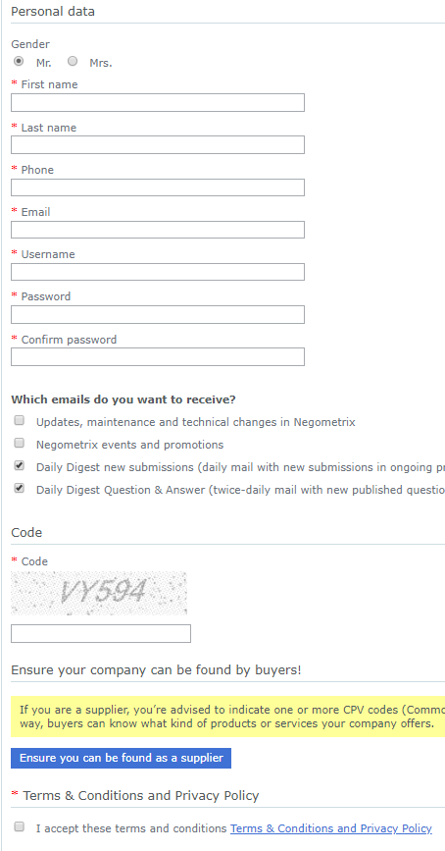
Register Company
Registration is very easy, probably the easiest of all the electronic solicitation systems.
Fill in the information as requested.

Slide 10
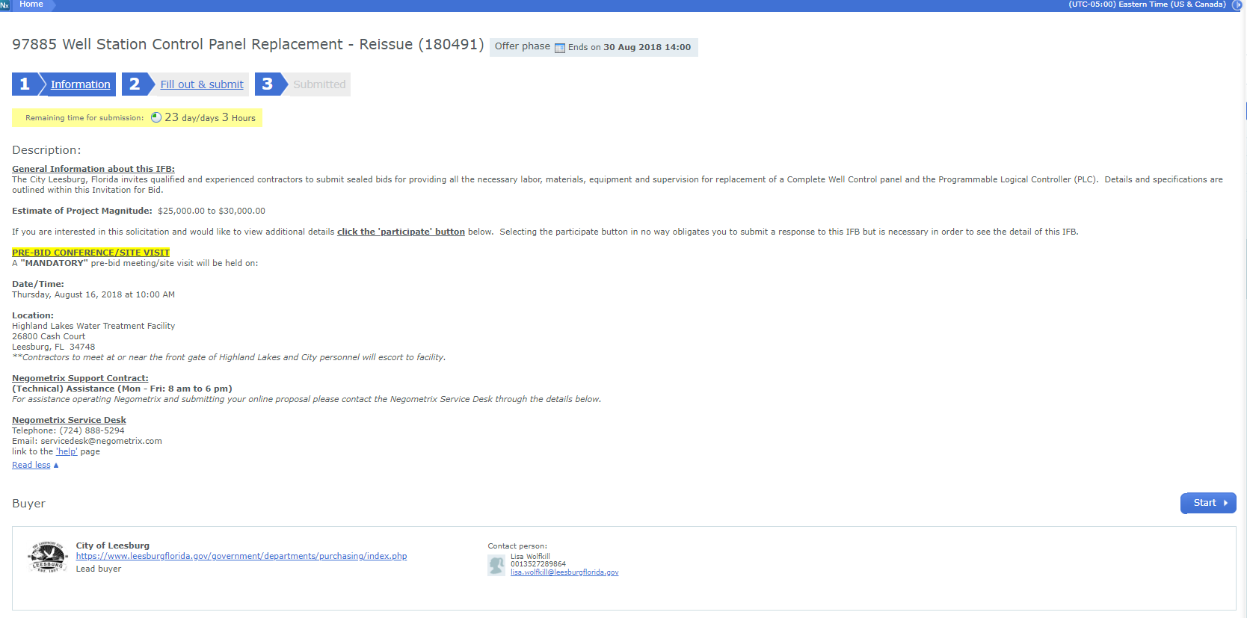
There are two halves to this screen.
The top half is the General Information. It provides the steps to take and provides the remaining time left to submit a response.
The bottom half is explained on the next page.

Slide 11
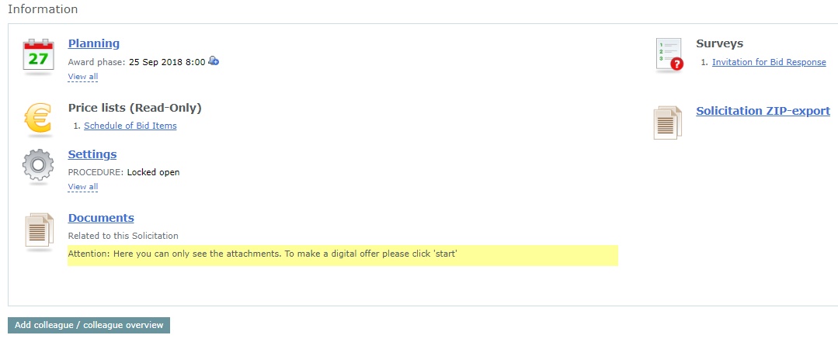
Planning – will show all the dates and phases associated with the solicitation.
Price Lists – Selecting this option will display the price lists for the solicitation.
Settings – Some general information relate to the solicitation.
Documents – Displays all documents for the solicitation for supplier review.
Surveys – These are the items suppliers must respond to in order to submit a bid response.
Add colleague/Colleague overview – use this option to invite a co-worker that may work on the solicitation with you.
Solicitation ZIP-export – This option will create a ZIP file for download of all information in the solicitation.

Slide 12
START
When you are ready to start your solicitation response, select the ‘Start’ button.
Selecting ‘Start’ does not obligate you to actually submit a response.

Slide 13
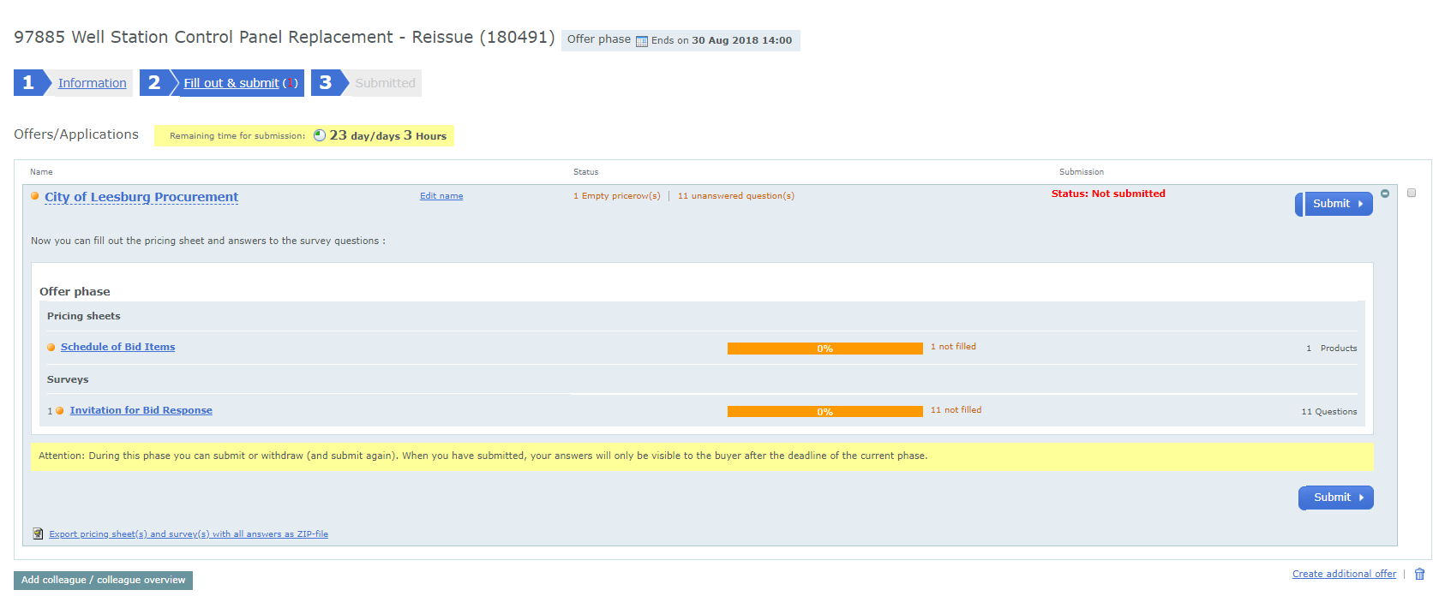
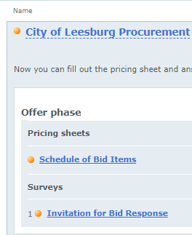
The blocks at the top of the screens show your progress. The remaining time for submission is also displayed and updated in real time.
The core of the response is displayed in the center of the screen under the heading
OFFER PHASE
This solicitation has a schedule of bid items to complete as well as surveys.

Slide 14
Definitions
Offer phase – The period of time when suppliers are able to start, fill out & submit responses (bids) to the solicitation.
Pricing Sheets – The Schedule of Bid Items or the prices suppliers are submitting for their response. The Town’s buyer prepares the pricing sheets.
Surveys - The system uses the term Survey to signify the questions the supplier must answer in response to this solicitation. Each solicitation is different and will have different Surveys, or questions, based on the commodity being purchased.

Slide 15
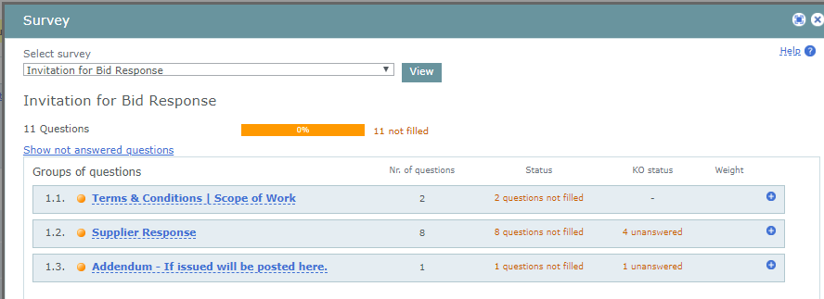
Selecting the ‘Invitation for Bid Response’ link on the previous screen will display this pop-up window.
In this window the groups of questions are displayed.
You can select any of the questions to expand the list and display the list of questions within each question group.

Slide 16
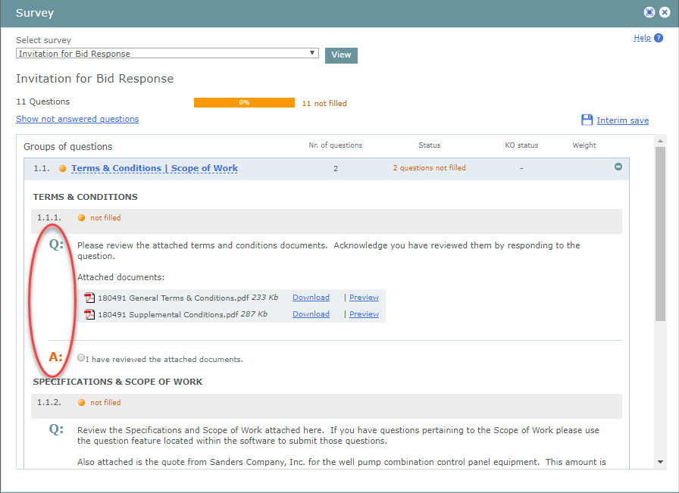
Interim save will save your progress. You will be able to come back later to complete your submission.
When you select any one of the Survey items the questions under that Survey will be displayed.
Status column will show you how many questions you have NOT answered.
This is a good way to check your progress an ensure you do not miss anything.
You can see here that each question has a Q and an A. The Q is the question or information provided by the City.
The supplier will respond in the A or Answer section.

Slide 17
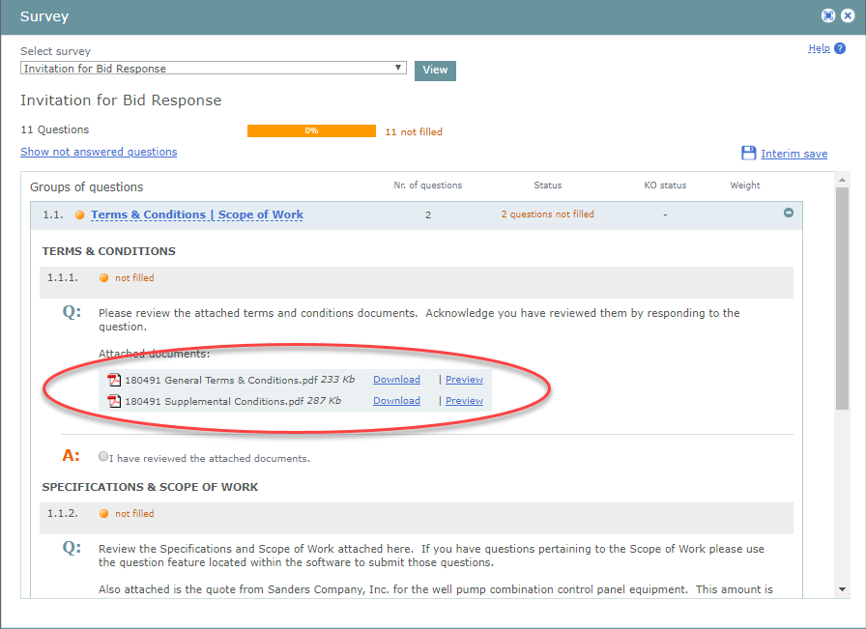
Attached documents can be viewed by either downloading them to your computer or selecting ‘Preview’ and they will be displayed in the browser window.

Slide 18
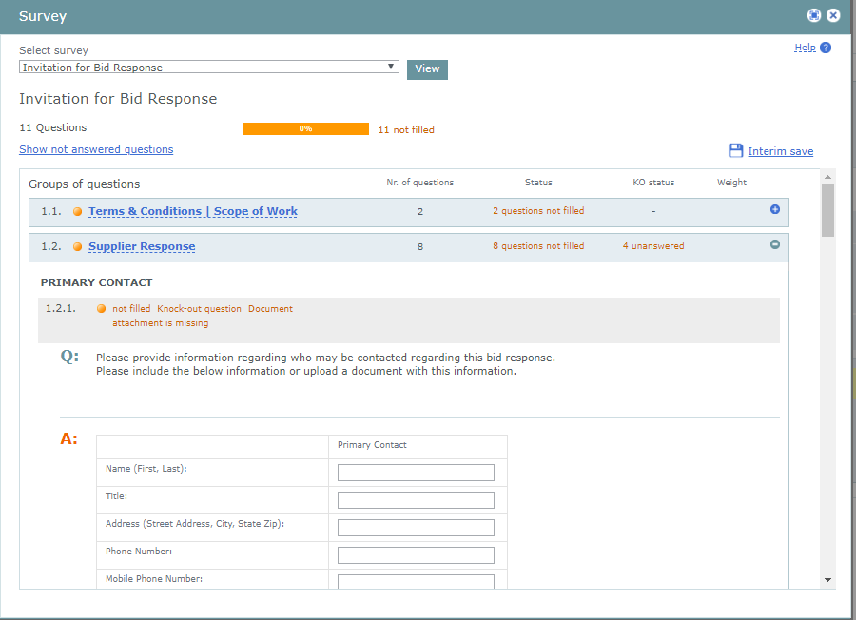
In this solicitation under the question group Supplier Response there are 8 questions to be filled in by the bidder.
This question actually requires the supplier to input information into the system.
Point of contact information in this example.
Other questions request other information.

Slide 19
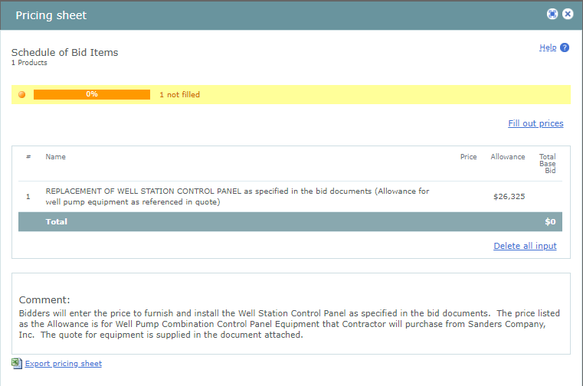
PRICE SHEET
This is the Price Sheet window.
To complete the price sheet you would select the ‘Fill out prices’ link.

Slide 20
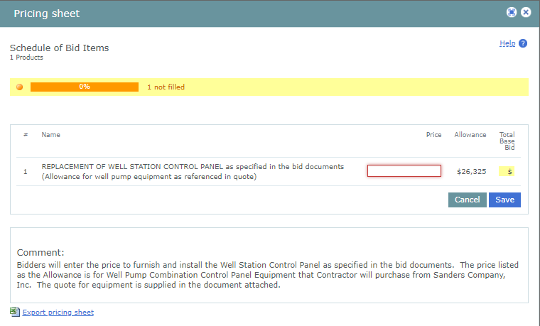
After selecting the ‘Fill out prices’ link the price field(s) to key your price(s) are opened for input.

Slide 21
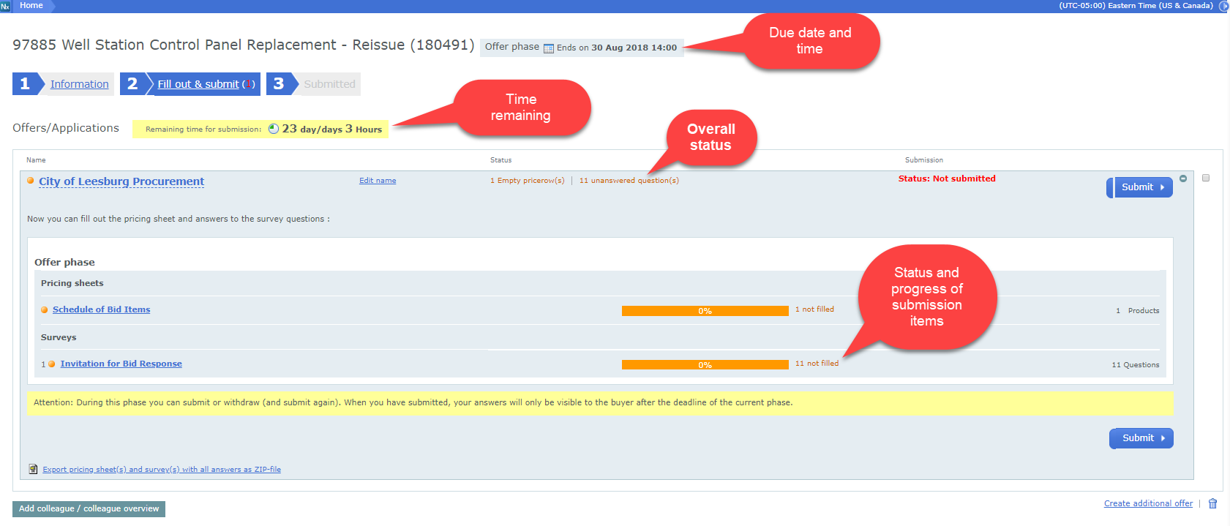
WRAP UP

Slide 22
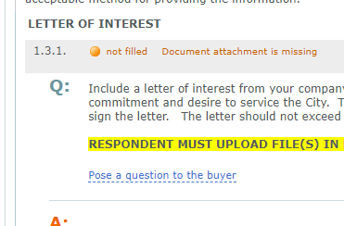
Questions and answers
Suppliers can submit a question to the Town by selecting the
‘Pose a question to the buyer’
link like the one shown here.

Slide 23
support
If you need assistance using the system or submitting your response you can contact the Negometrix support by phone or email.
(724) 888-5294
Email: servicedesk@negometrix.com
Hours: 7:00 AM to 5:00 PM EST

