Slide 1
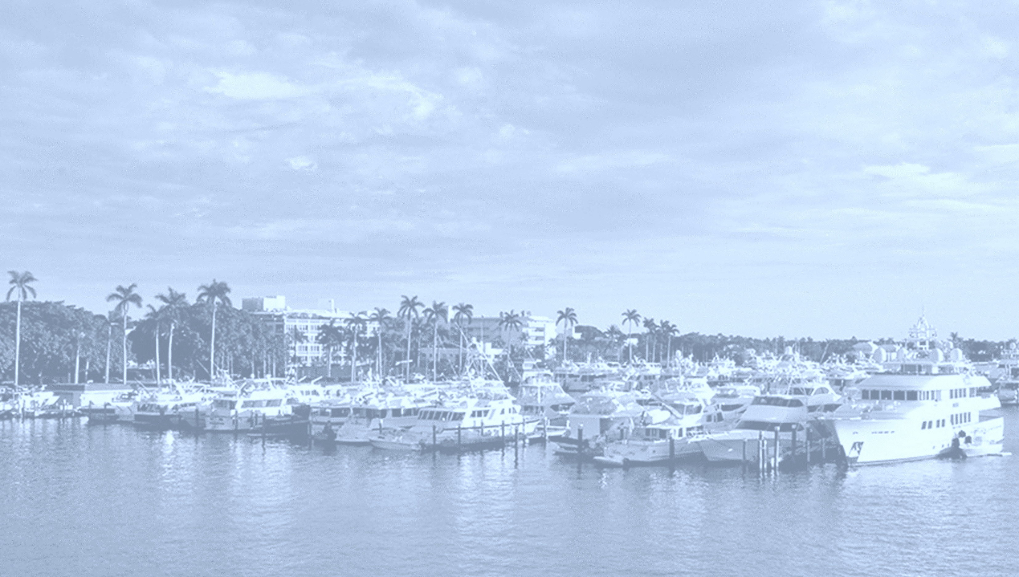

Town Marina Project
Bidder Workshop
August 15, 2019

Slide 2
Meeting Outline
Introduction
Objective is to engage qualified firms to propose for this project
Cone of Silence
Proposal Format and Selection Process
Estimated Schedule
Project Elements
  Dredging & Disposal
  Demolition
  Floating Docks
  Bulkhead
  Buildings
  Upland

Slide 3
Introduction
Proposers will be required to submit electronically through our E-bidding platform, Negometrix as well as submit a paper proposal. The Town will require ten (10) copies of paper submissions.

Slide 4
Proposal Format and Selection Process
Request for Proposal (qualifications and cost-based selection)
  Cost as a component
  Evaluation of team, capabilities and experience
  Work Plan and Equipment
  Schedule
  And other factors that will be determined as solicitation is prepared

Slide 5
Estimated Schedule
Item | Start | End
Workshop with Contractors | August 15
Advertisement Period (issue RFP) | September 4 | December 2
Pre-Proposal Meeting | September 25
Selection Process | December 3 | January 13, 2020
Negotiation | January 27, 2020 | February 25
Town Council Meeting | March 10
Contract Award & NTP | April 1
Construction Start | May 1

Slide 6
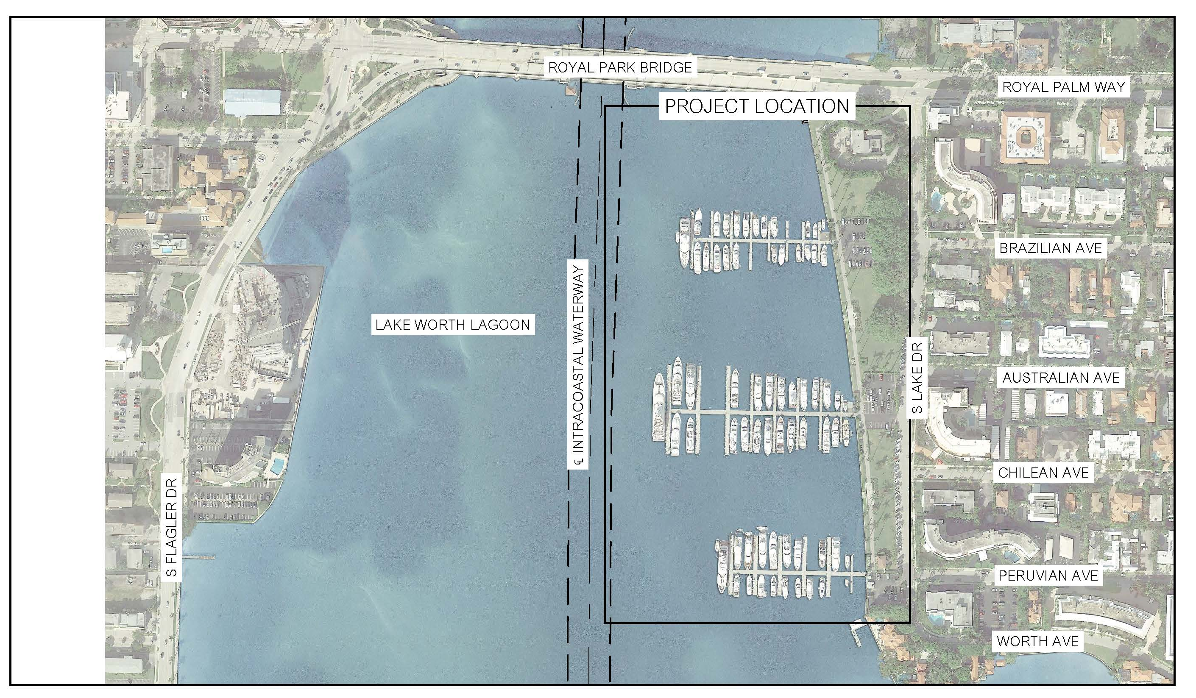
Project Elements
Dredging & Disposal
Demolition
Floating Docks
Bulkhead
Upland

Slide 7
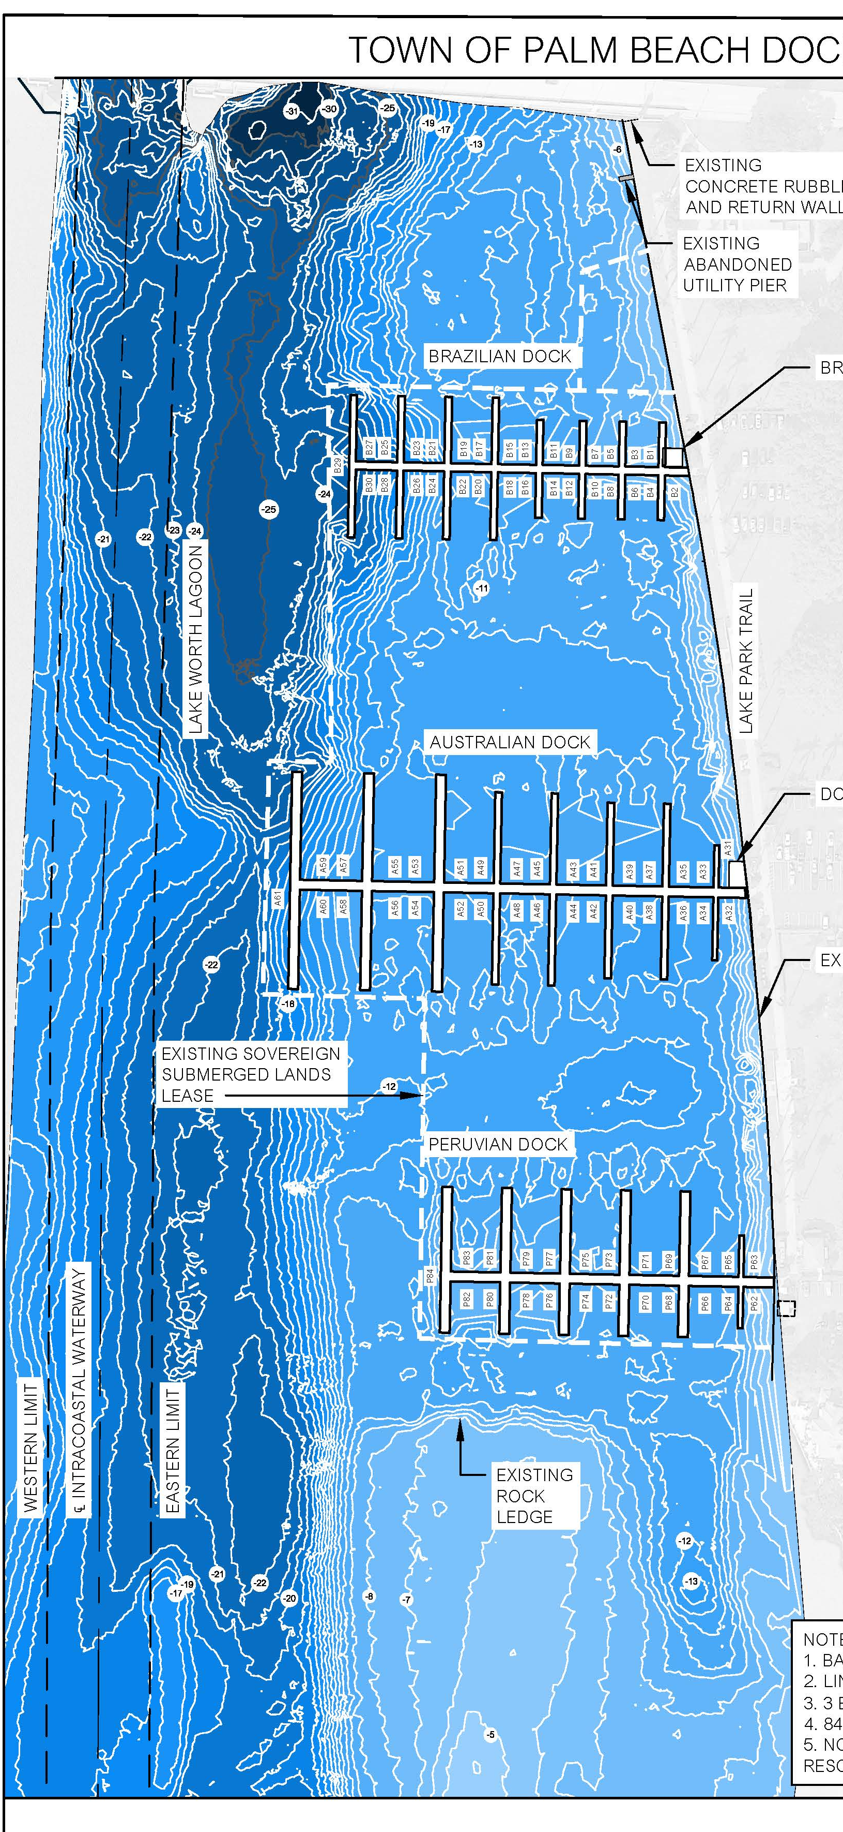
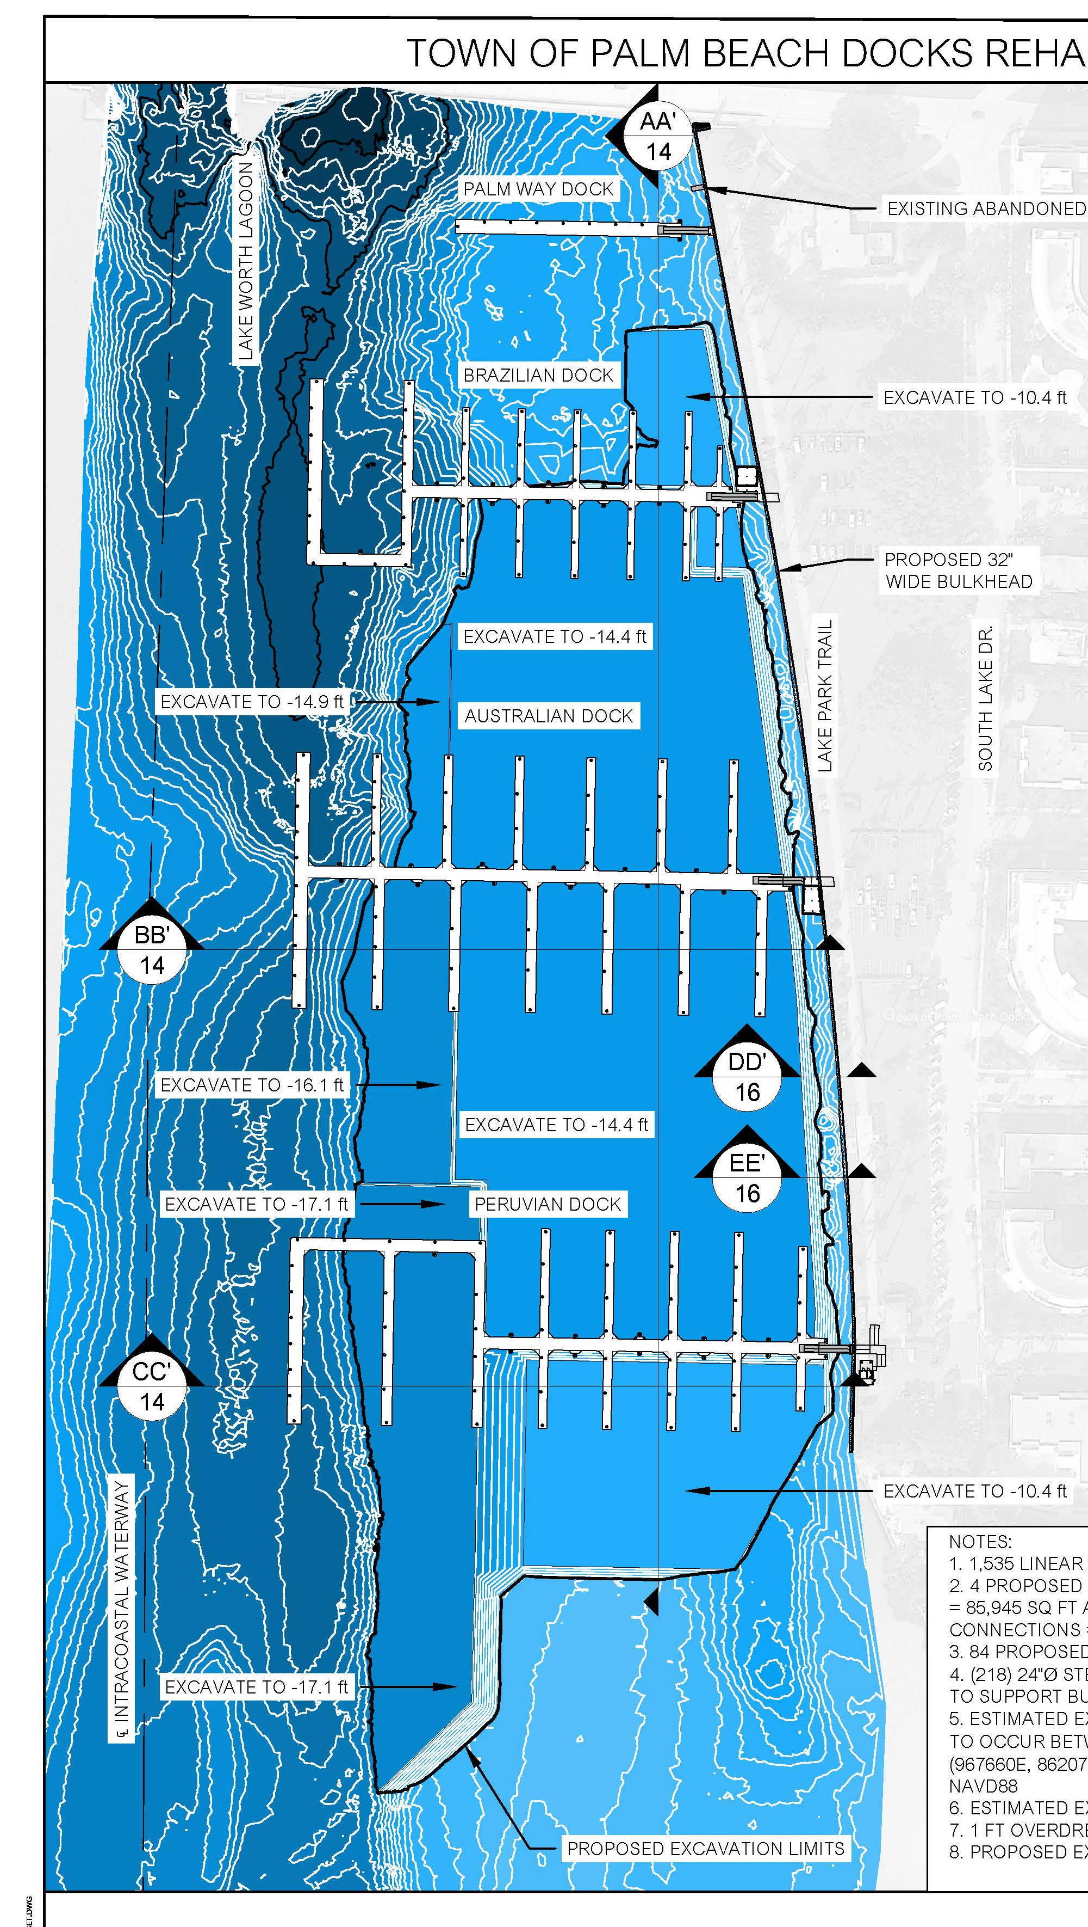
Dredging & Disposal
90,500 cy
  Variety of dredge depths
    -10.4’ NAVD to -17.7’ NAVD
  Mechanical excavation only
  Mixture of rock and sand
    ~50-60% rock, 40-50% sand
  We have probes and cores
  Typical turbidity control
    Permitted wood piles to hold the curtain
Existing Conditions
Proposed Conditions

Slide 8
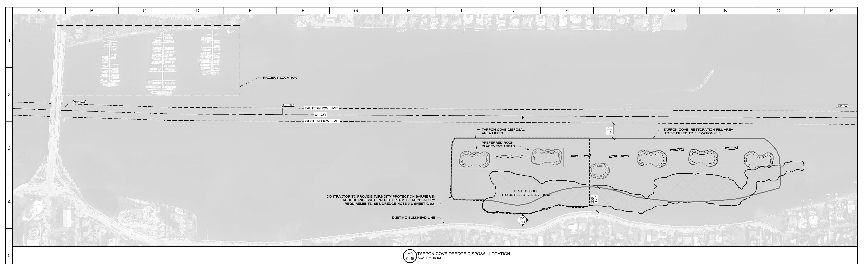
Dredging & Disposal
Disposal will be northern end of Tarpon Cove
0.4 miles

Slide 9
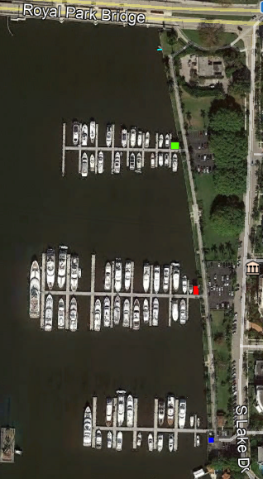
Building Demolition
Three buildings
  Brazilian (one story, over water)
  Australian (two story, over water)
  Peruvian (one story, land based)
Building pads for over water structures
  Concrete Pad
  Concrete support beams
  Concrete piles
Utility pier at north end

Slide 10
Dock Demolition
Docks are fixed, concrete pile supported docks
Concrete bents
Aluminum decking
Typical utilities
Sufficient as-builts are available and will be provided

Slide 11
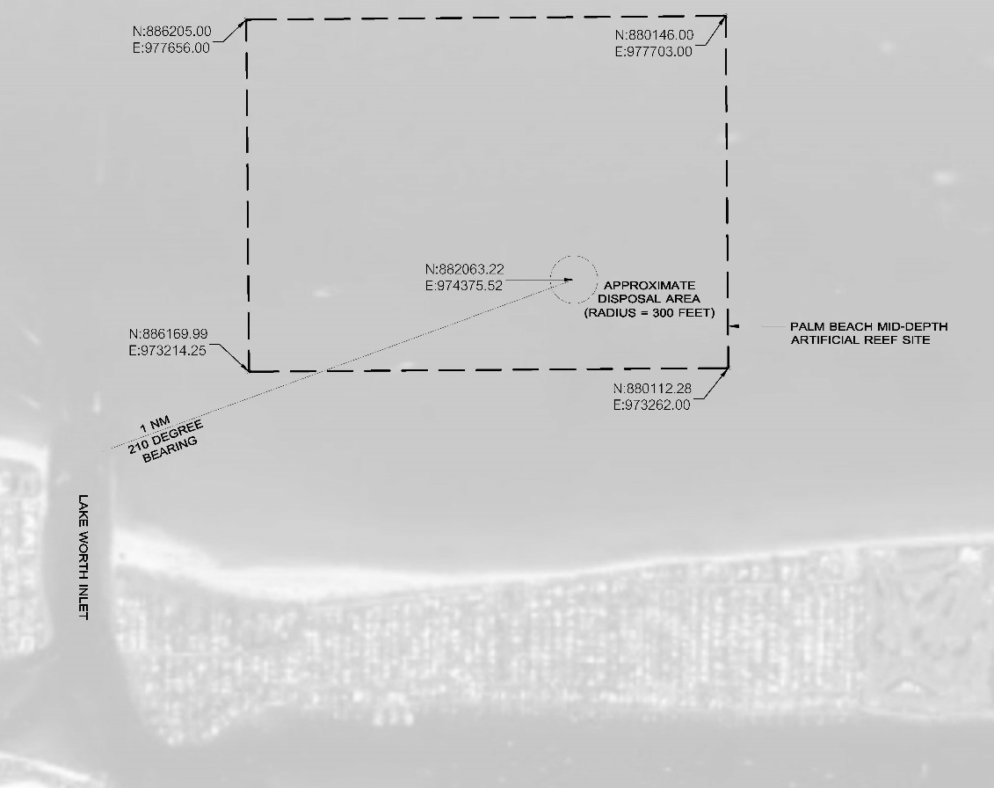
Demolition
Building material and utility infrastructure to be disposed of at an upland landfill
Concrete pieces may be disposed of offshore
  Palm Beach County Mid-Depth Artificial Reef
  1 mile from Lake Worth Inlet
  Pieces must be sufficiently large

Slide 12
Floating Docks
Design, manufacture and install four new concrete floating docks
  Layout and performance criteria will be provided
Three manufacturers have been pre-qualified to provide the docks:
  Bellingham Marine
    Kevin Thompson, kthompson@bellingham-marine.com, (904) 380-3271
  EMC USA LLC
    Michael Bolchoz, michael.bolchoz@emgmarinas.com, (803) 727-8579
  SF Marina Systems USA
    Mason Sears, hmsears@sfmarinausa.com, (207) 347 4237
Only docks from pre-qualified manufacturers will be accepted

Slide 13
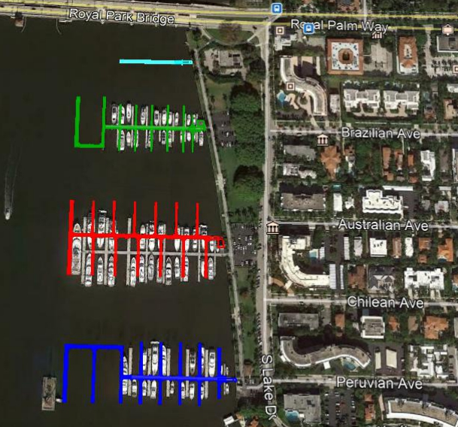
Floating Docks
Palm Way
77 slips + 7 MST
Vessels 55’ to 294’
Headwalk 14-16’
Fingers 8-12’
~85,375 sf of deck
Brazilian
Australian
Peruvian

Slide 14
Floating Docks
Steel sheet pile with coal tar epoxy and HDPE sleeves
  Sizing and location of piles to be determined by dock manufacturer to meet performance criteria
    24” steel piles preferred but not absolute requirement
    Chain and anchor system prohibited
    Geotechnical report will be provided
Town will direct purchase docks and piles from your selected manufacturer

Slide 15
Floating Docks
Utilities
  Contractor will provide and install all utilities within project limits
  Electrical
    Combination of 208V, 240V and 480V
    Upland transformers will be provided by FPL
    Electrical panels will be on docks
    Power pedestals will provide a variety of power options
    Power Pedestals to provide individual and wireless feed of consumption to Dock Master’s office
  Water, Sewer, Fire
    Will require new lift station for sanitary hook-up
    New lines extending to Palm Way Dock

Slide 16
Floating Docks
Gangways
  8’ wide, 52.5’ long
  Handrails shall be lighted
Security gates
  Contractor to manufacture and install
  Cell phone operated application
  Ability for Dock Master to control access
Wi-Fi
  Contractor shall install wi-fi throughout the marina
  Existing wi-fi equipment can be salvaged and re-used

Slide 17
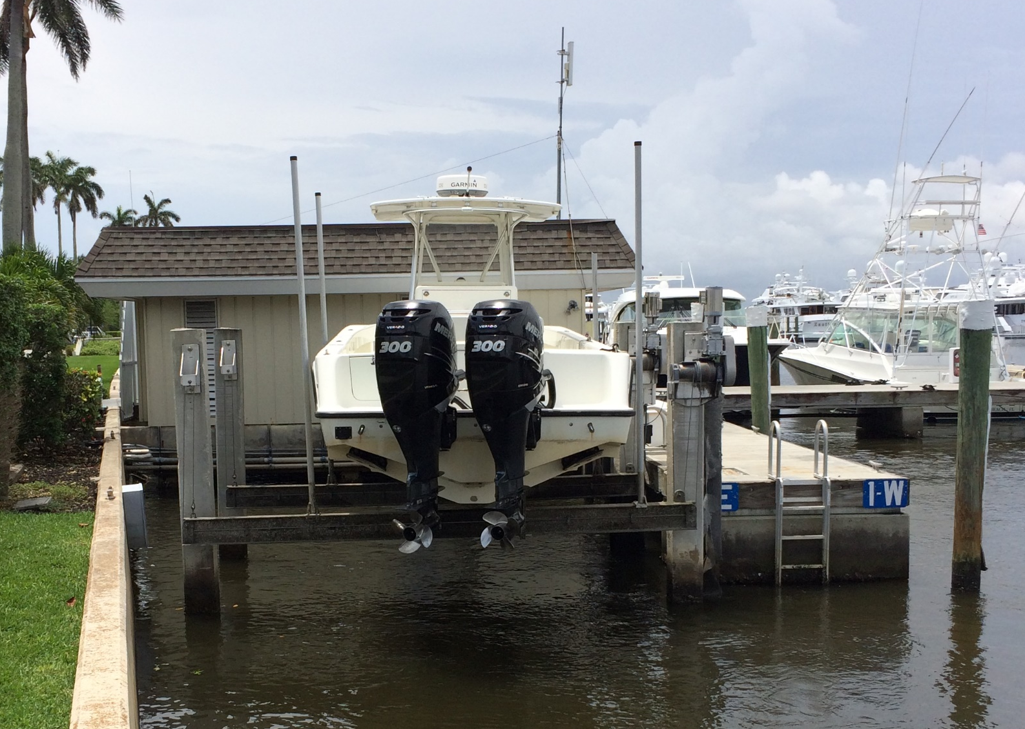
Floating Docks
Security Cameras
  Security cameras shall be provided and installed throughout the marina
  Connection to the Dock Master’s office and Police
Remove and reinstall Police Dock boat lift
Install gangway abutments
  Palm Way and Peruvian
  Brazilian and Australian abutments part of building padpad

Slide 18
Bulkhead
Install a new bulkhead in front of the existing bulkhead
  1,536 feet long
  2’ higher than existing cap
  Cantilever, steel sheet pile with concrete cap
  Town can direct purchase sheet pile
Trim the cap on the existing bulkhead 6” below existing grade
There are two existing pump stations with discharge pipes
  Uncouple and extend the discharge pipes through the new bulkhead

Slide 19
Buildings
Reinstall concrete pads for the two over water buildings
  Brazilian and Australian
  Slightly different location than present for Brazilian and Australian
  Concrete pre-stressed piles
  Poured in place concrete pad
Construct three buildings
  Brazilian building – 2 story, 528 sf base floor (1,056 total)
  Australian building – 1 story, 640 sf
  Peruvian building – 1 story, 243 sf enclosed, 174 sf open covered space

Slide 20
Buildings
Brazilian Building

Slide 21
Buildings
Australian Building

Slide 22

Buildings
Peruvian Building

Slide 23
Upland
Remove existing ramps from Lake Trail to the docks
Install new ramps
  ADA compliant ramp and retaining walls
Landscape around parking lots, buildings, upland equipment and along bulkhead
  Will require removal of existing vegetation
Revise existing irrigation system

Slide 24
Upland
Determination, permitting and connection of utilities
Parking Lot
  Mill and resurface three parking lots
  Restripe
Two new cross-walks along South Lake Drive

Slide 25
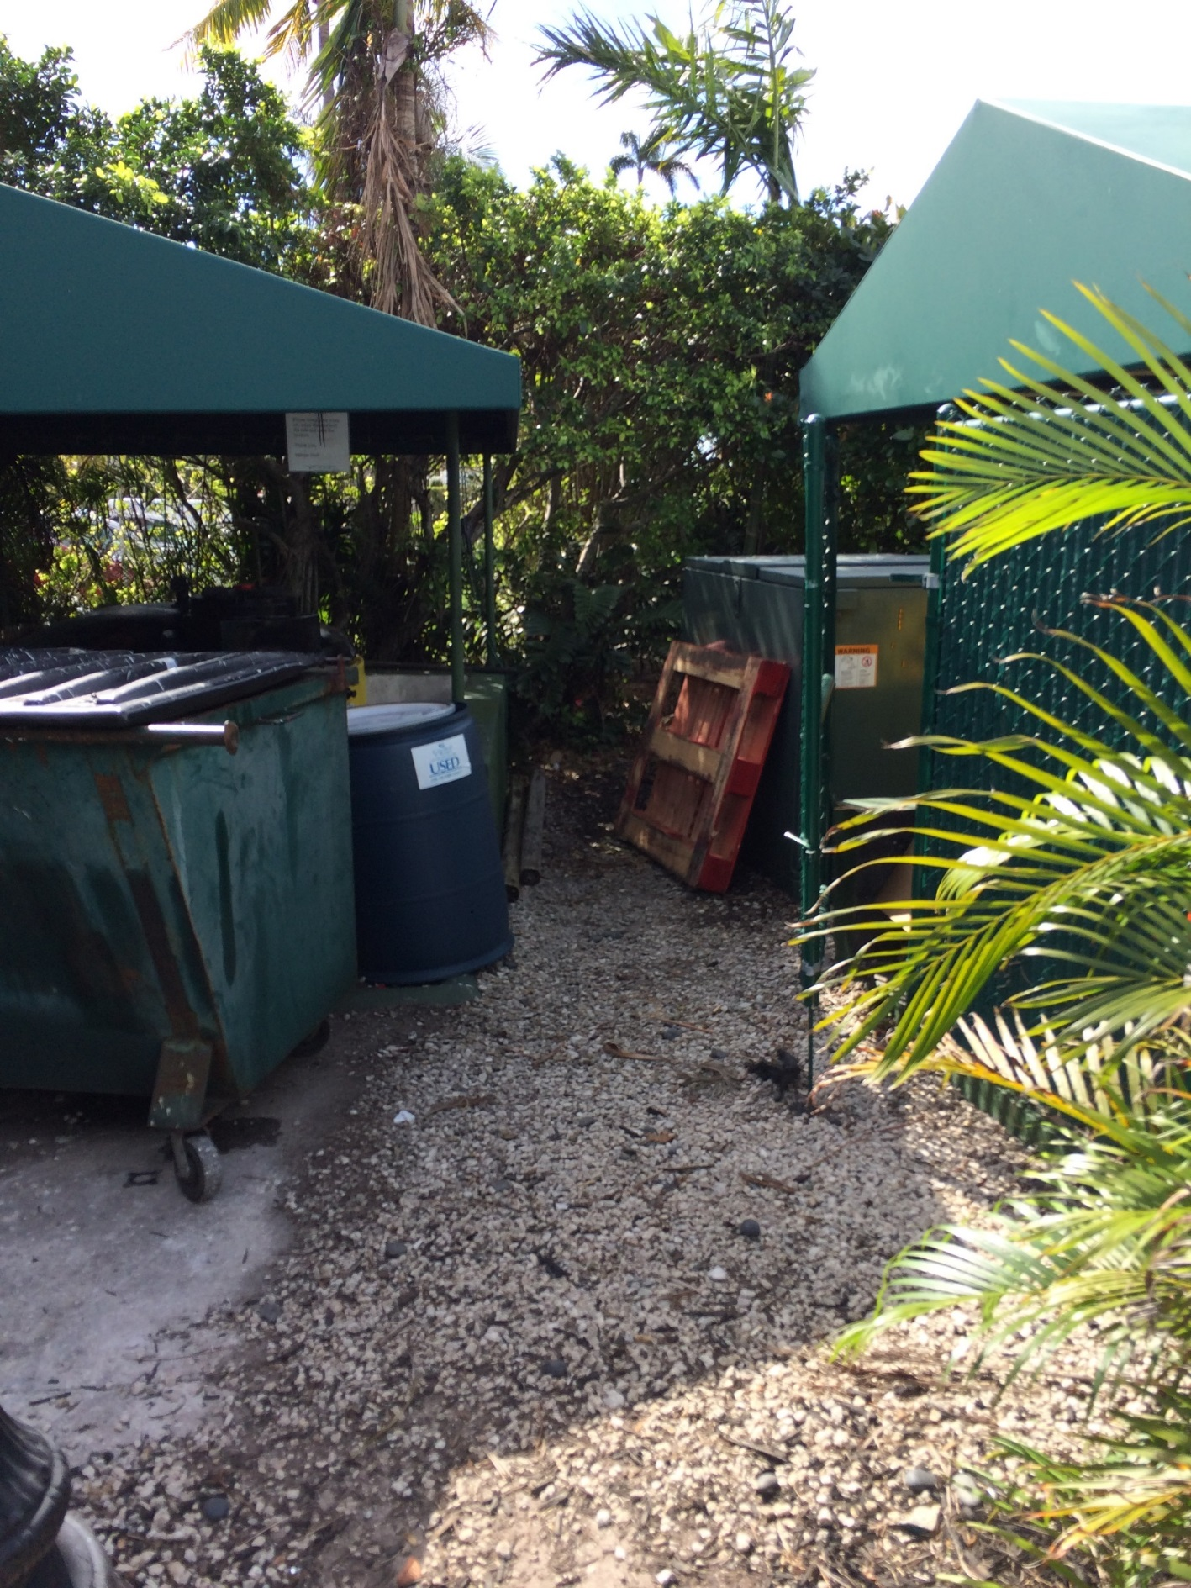
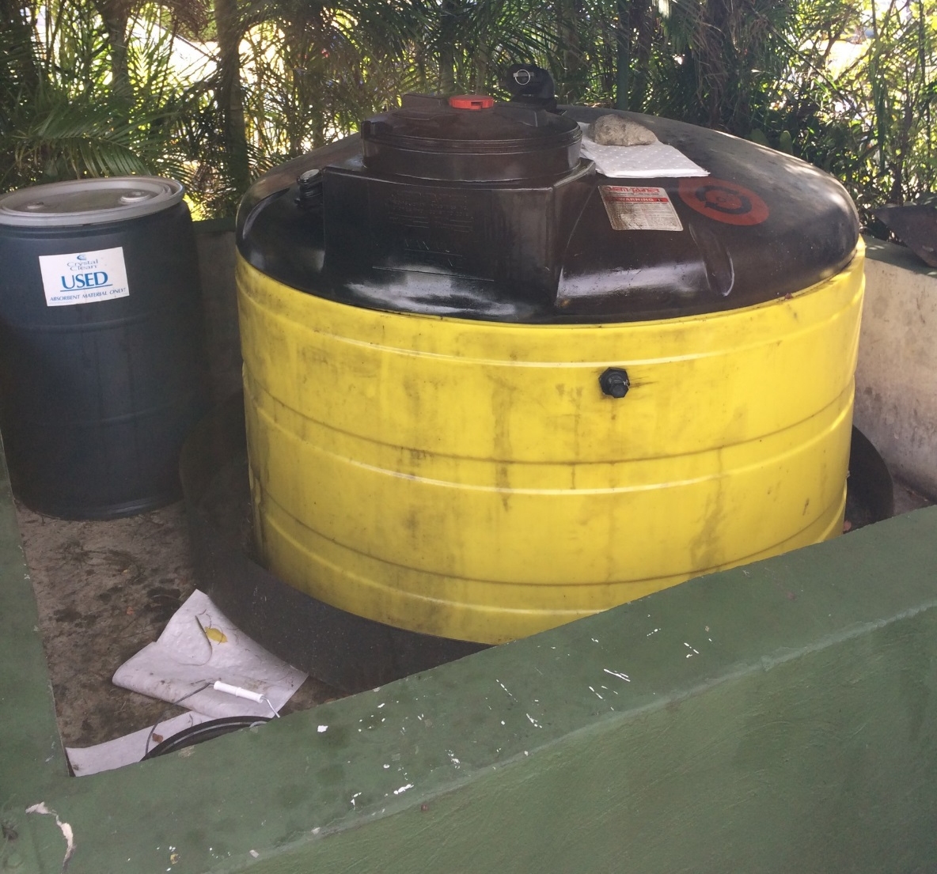
Upland
Trash Collection Area
  Remove existing waste oil storage area
  Relocate light poles
  Install reinforced concrete pad for trash compactor
  Install perimeter landscape fence around trash collection area

Slide 26
Questions

